Slide 1
TELEGRAM
Maximizing Communication via Hearing Assistance Technology

Slide 2
Introduction
There are many factors to consider in determining candidacy for amplification, and in many cases communication difficulties may be reduced through the use of hearing aids.
However, there may be circumstances or situations in which hearing aids don’t completely compensate for the loss.
In these cases, other devices techniques, and/or strategies must be considered.

Slide 3
Goal : to maximize patient’s communication abilities.
Audiologists are encouraged to broaden their scope of service beyond the hearing instrument to encompass their overall communication needs.
How is this achieved? - the TELEGRAM

Slide 4
What is the TELEGRAM?
Convenient prompt for audiologists to use with every client to ensure a comprehensive assessment of communication needs.
Includes areas that must be considered in a broad investigation of theses needs.
Plotted for efficient summarization of results just as the AUDIOGRAM.

Slide 5
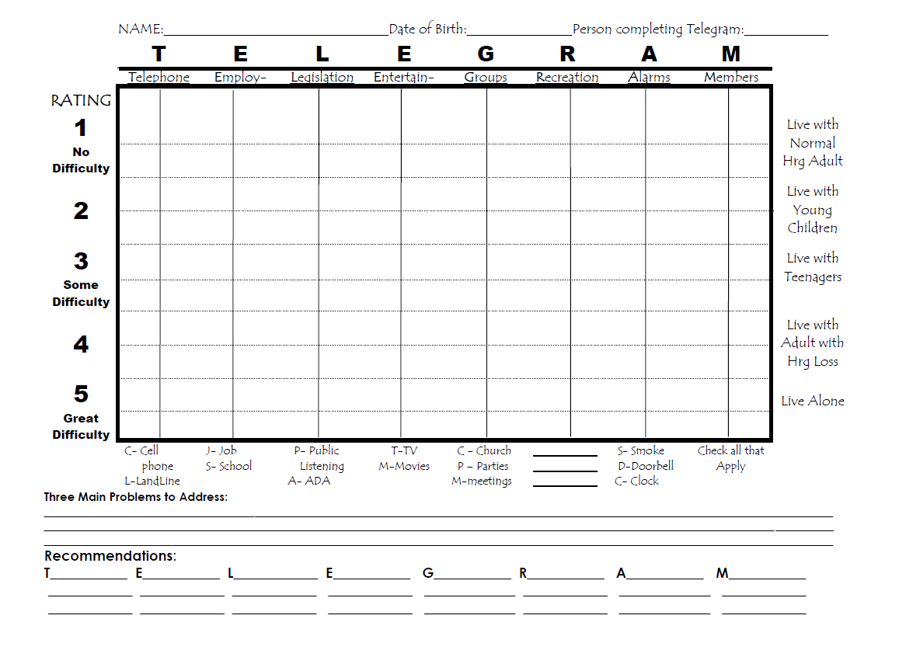

Slide 6
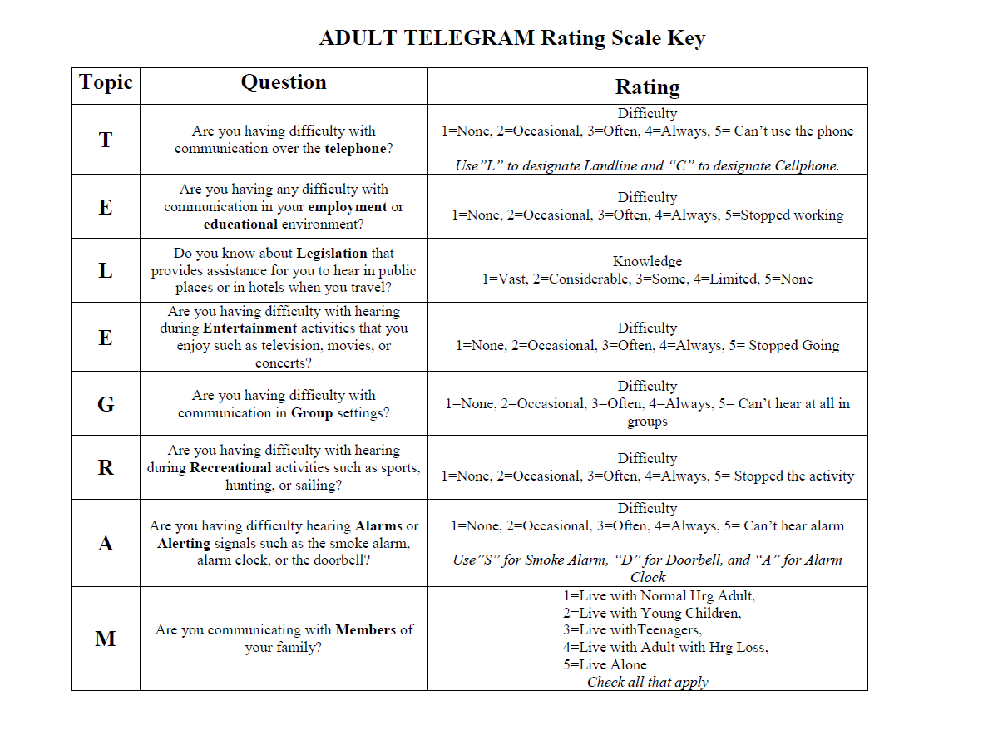
Do you live alone or with others?

Slide 7
TELEGRAM
Areas that must be considered:
Telephone
Employment
Legal issues
Entertainment
Group Communication
Recreation
Alarms
Members of the family

Slide 8
TELEGRAM Interpretation
Obtaining information regarding the client’s functioning in each of these areas will lead to recommendations for additional technology or information that will maximize communication.

Slide 9
T - Telephone
Are you having difficulty communication over the Telephone?
Difficulty
1 = None
2 = Occasional
3 = Often
4 = Always
5 = Can’t use the phone
Use “L” to designate Landline and “C” to designate Cellphone.

Slide 10
C

Slide 11
E – Employment/Education
Are you having any difficulty with communication in your Employment or Educational environment?
Difficulty
1 = None
2 = Occasional
3 = Often
4 = Always
5 = Stopped working

Slide 12
C
S

Slide 13
L - Legislation
Do you know about Legislation that provides assistance for you to hear in public places or in hotels when you travel?
Knowledge
1 = Vast
2 = Considerable
3 = Some
4 = Limited
5 = None

Slide 14
C
S
PA

Slide 15
E - Entertainment
Are you having difficulty with hearing during Entertainment activities that you enjoy such as television, movies, or concerts?
Difficulty
1 = None
2 = Occasional
3 = Often
4 = Always
5 = Stopped Going

Slide 16
C
S
TM
PA

Slide 17
G - Group
Are you having difficulty with communication in Group settings?
Difficulty
1 = None
2 = Occasional
3 = Often
4 = Always
5 = Can’t hear at all in groups

Slide 18
C
S
TM
PA
PM

Slide 19
R - Recreation
Are you having difficulty with hearing during Recreational activities such as sports, hunting, or sailing?
Difficulty
1 = None
2 = Occasional
3 = Often
4 = Always
5 = Stopped the activity

Slide 20
C
S
TM
PA
PM
R
R - Rock Climbing

Slide 21
A - Alarms
Are you having difficulty hearing Alarms or Alerting signals such as the smoke alarm, alarm clock, or the doorbell?
Difficulty
1 = None
2 = Occasional
3 = Often
4 = Always
5 = Stopped the activity
Use ”S” for Smoke Alarm “D” for Doorbell, and “A” for Alarm Clock

Slide 22
SC
C
S
TM
PA
PM
R
R - Rock Climbing

Slide 23
M - Members
Are you communicating with Members of your family?
1 = Live with Normal Hearing Adult
2 = Live with Young Children
3 = Live with Teenagers
4 = Live with Adult with Hearing Loss
5 = Live Alone
Check all that apply

Slide 24
=
SC
C
S
TM
PA
PM
R
R - Rock Climbing

Slide 25
Do you live alone or with others?

Slide 26
Why use the TELEGRAM?
Using the combination of the AUDIOGRAM with the TELEGRAM would allow the audiologist to explain the sensory loss along with a broad assessment of communication needs that may be addressed with assistive technology.

Slide 27
Conclusion
A new format for assessment like the TELEGRAM, will allow audiologists to routinely consider the need for Hearing Assistive Technology in clinical practice.
For communication to be truly maximized in persons with hearing loss, the audiologists must consider beyond the audiogram and explore other devices, techniques, and/or strategies that will achieve this goal.

Slide 28
References
Thibodeau, L. (2008). How TELEGRAMs can help patients “Reach out and tough someone”. The Hearing Journal, 61(3), 10-17.
Thibodeau, L. (2004). Plotting beyond the audiogram to the TELEGRAM, a new assessment tool. The Hearing Journal, 57(11), 45-51.

